Slide 1
MUZIX APP
Presented By Guided By
TEAM 6 Ram Kumar.k

Slide 2
TEAM MEMBERS
Sandra Jomol V.K (218162) – Home page and Image upload application
Yalagandula Sahithi (201765) – Registration and Login
Shabna Hasheeb (210889) – Favourite and Recommend

Slide 3
INTRODUCTION
Music is one of the best ways to relieve pressure in
stressful modern society life.
This app is help us to access a vast variety of music.
Hearing at home,during work or so it provides a vast variety of music to the listeners.

Slide 4
OBJECTIVE
The primary purpose of this music streaming application
is to play music available in home page.
Add songs to favourite list.
If whatever will give to favourite it will comes inside the recommend also.

Slide 5
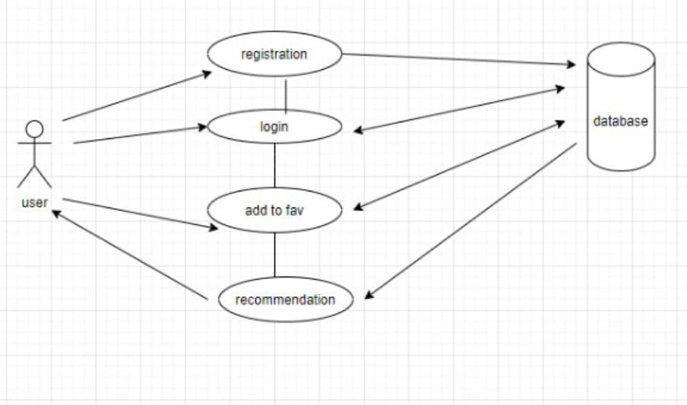
USE CASE DIAGRAM

Slide 6
MODULES
i) USER MODULE
Registration Page
Login Page
ii) FAVOURITE MODULE
iii) RECOMMEND MODULE

Slide 7
REGISTRATION PAGE
New user have to enter username
Give mobile number
Give email id
Give new password
Upload profile picture
All the fields are mandatory in registration page

Slide 8
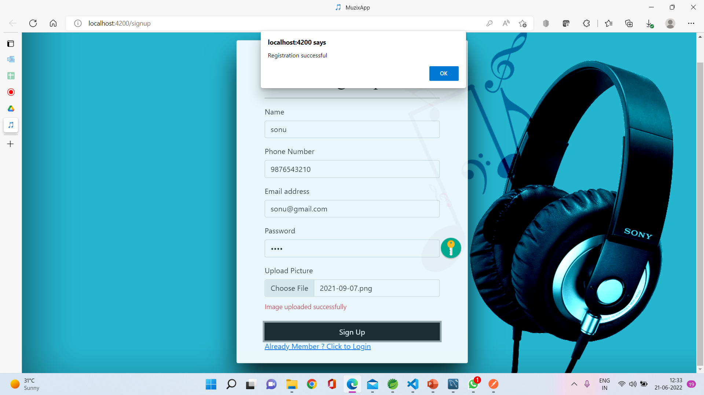
REGISTRATION PAGE

Slide 9
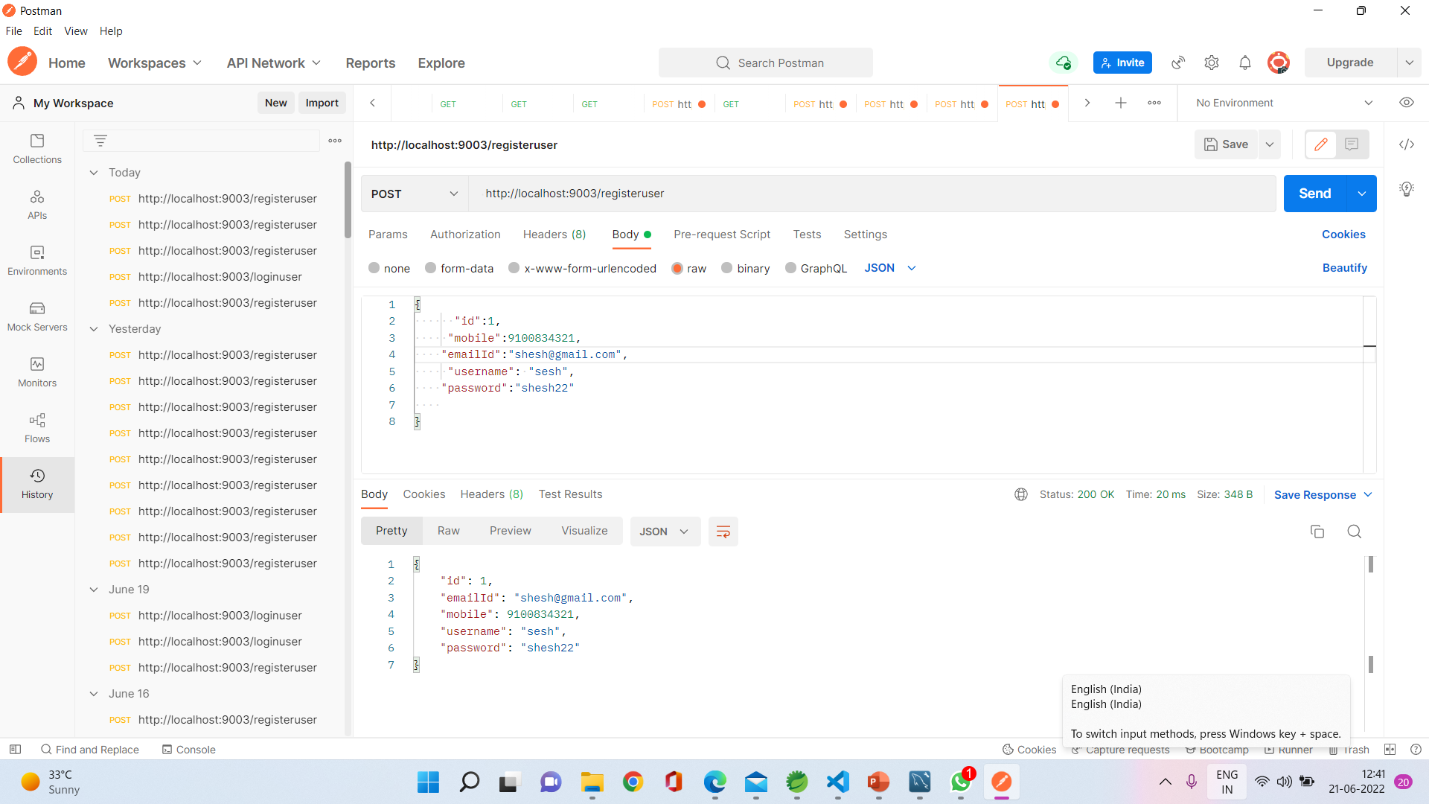
POSTMAN SCREENSHOT OF REGISTRATION

Slide 10
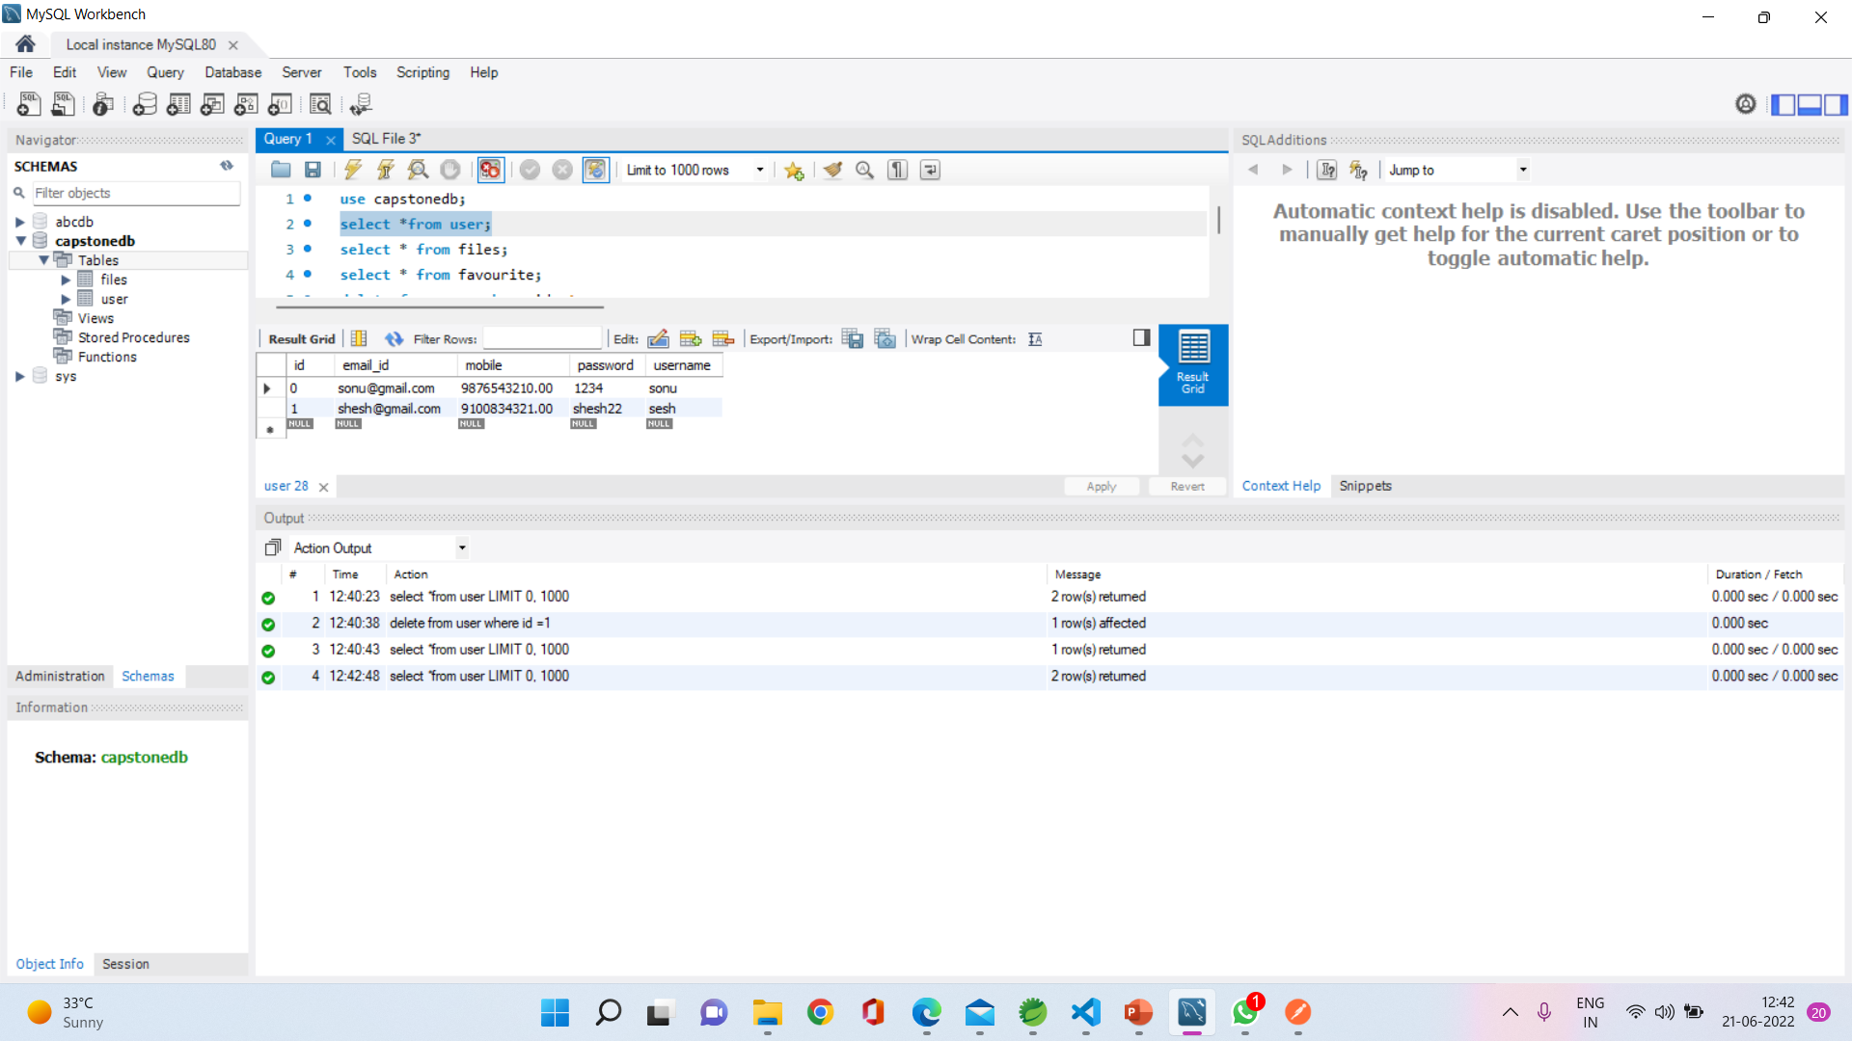
DATABASE SCREENSHOT OF REGISTRATION

Slide 11
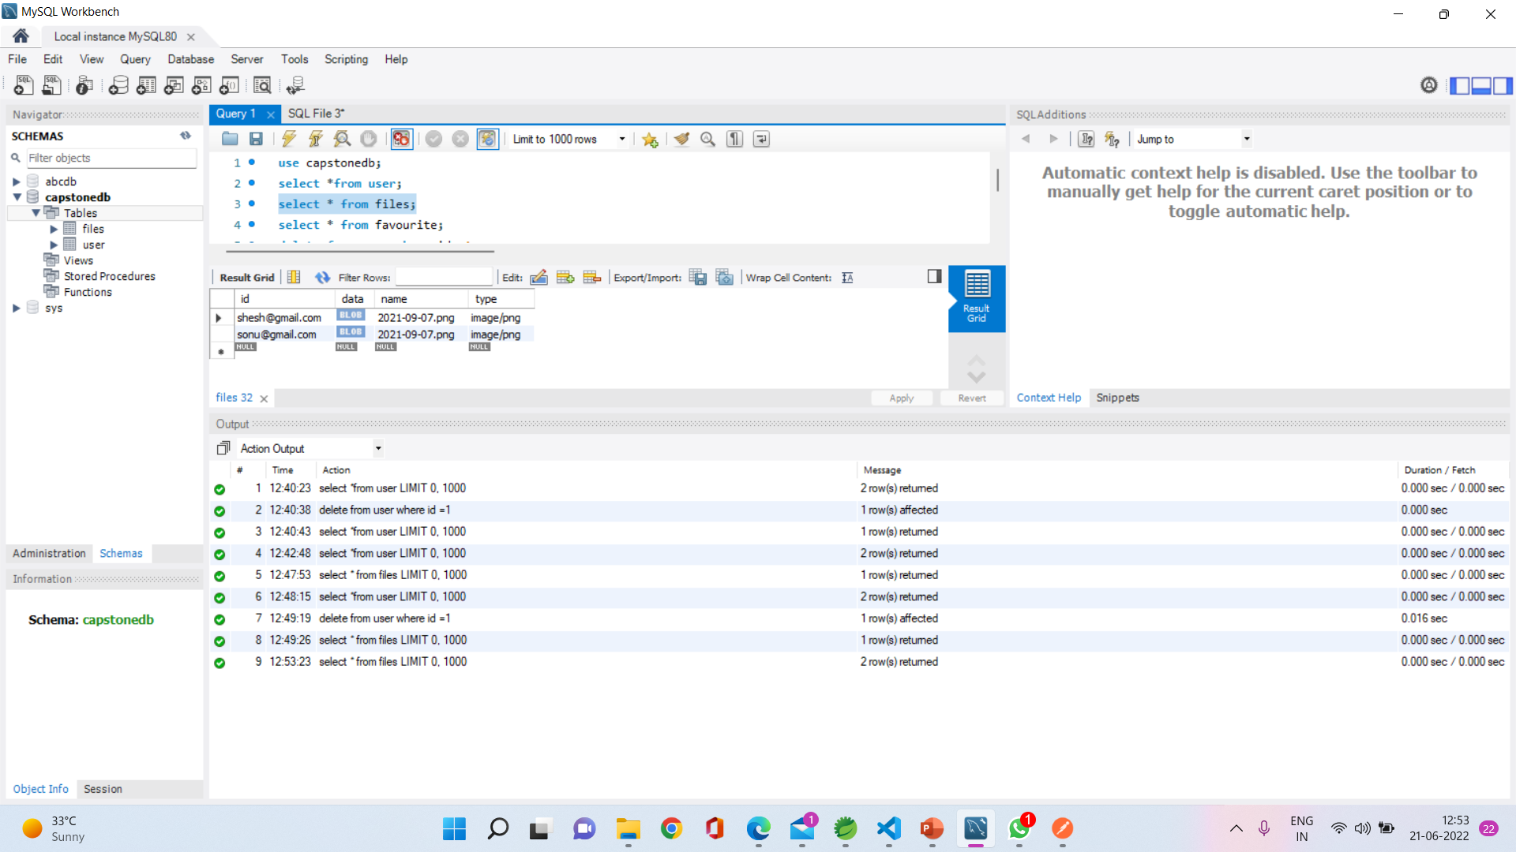
DATABASE SCREENSHOT OF ADDING IMAGE IN REGISTRATION

Slide 12
LOGIN PAGE
Existing user have to enter existing email id
Then give password
All fields are mandatory
If entered wrong email id or password it will throw error
Otherwise direct to display all page

Slide 13
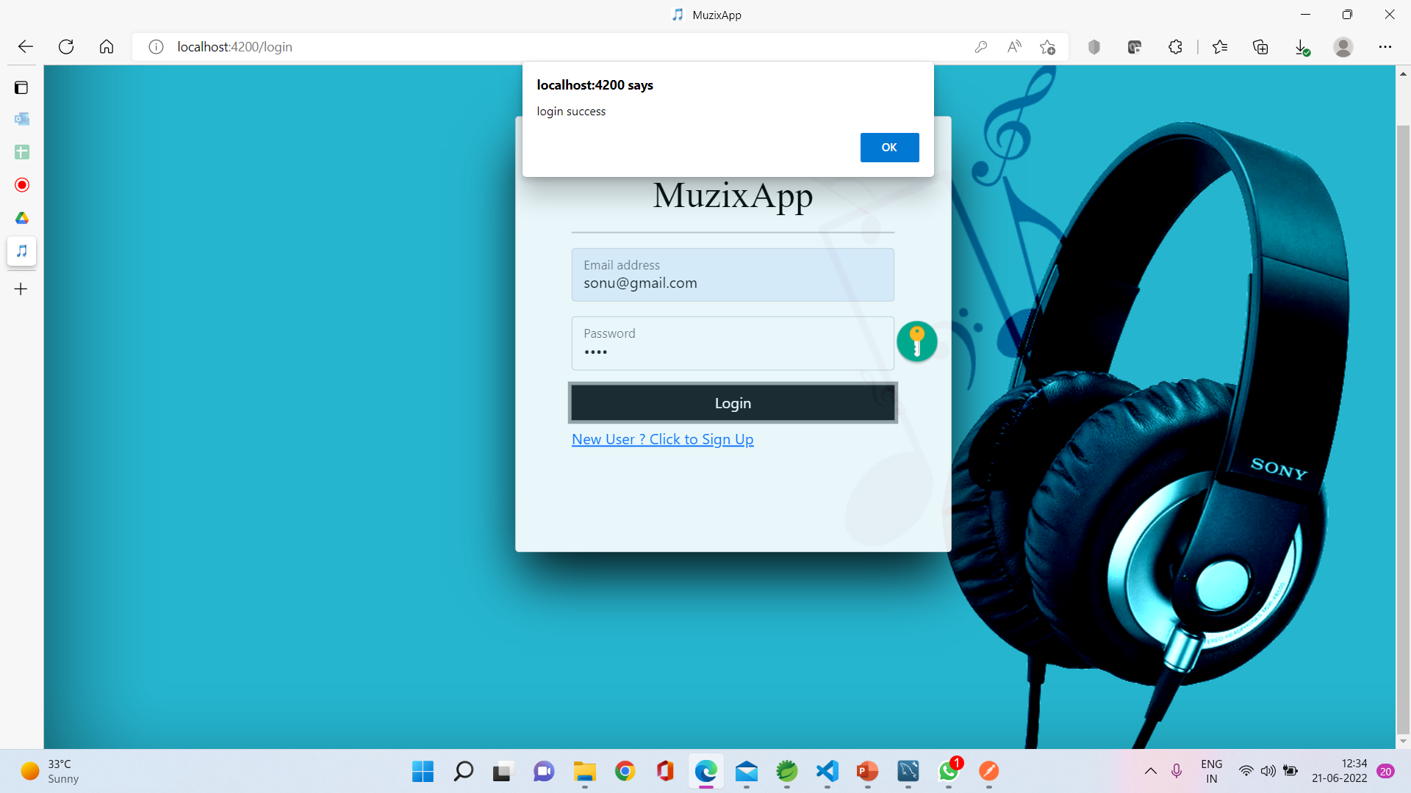
LOGIN PAGE

Slide 14
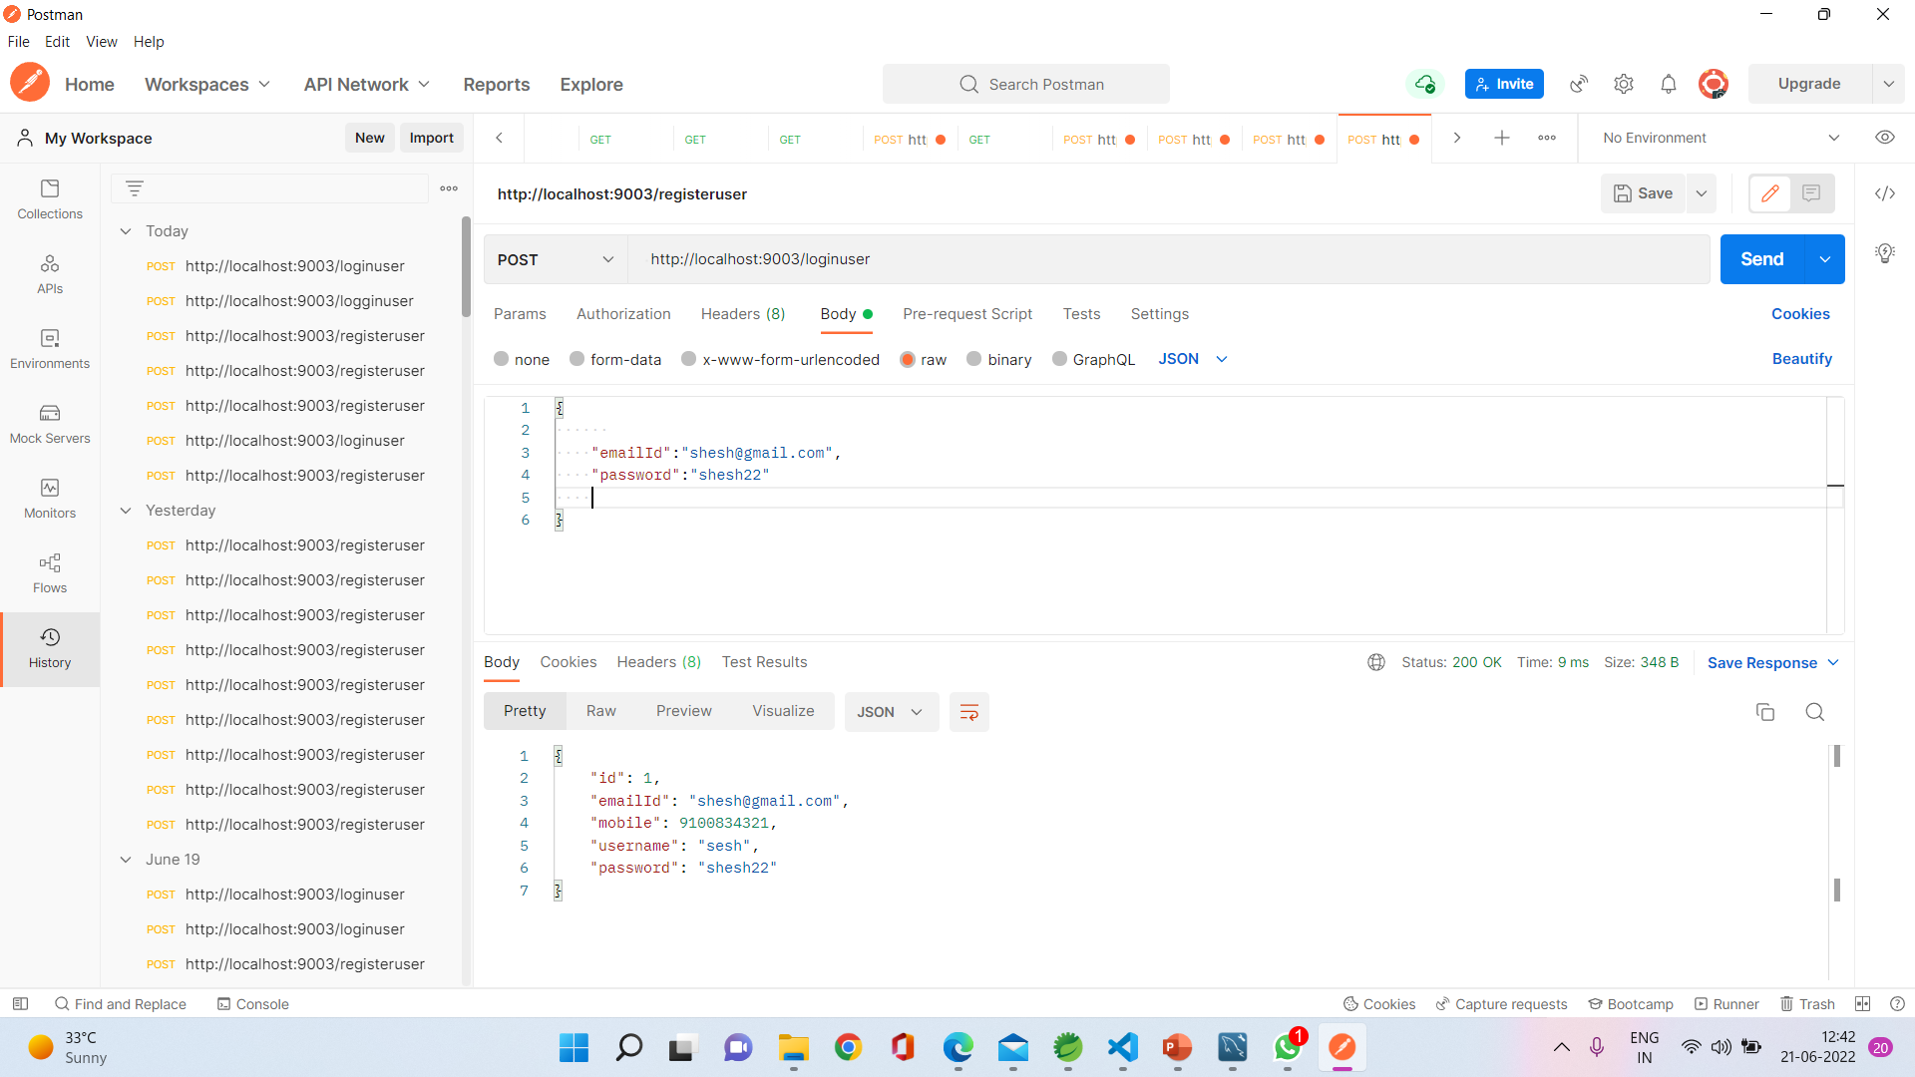
POSTMAN SCREENSHOT OF LOGIN

Slide 15
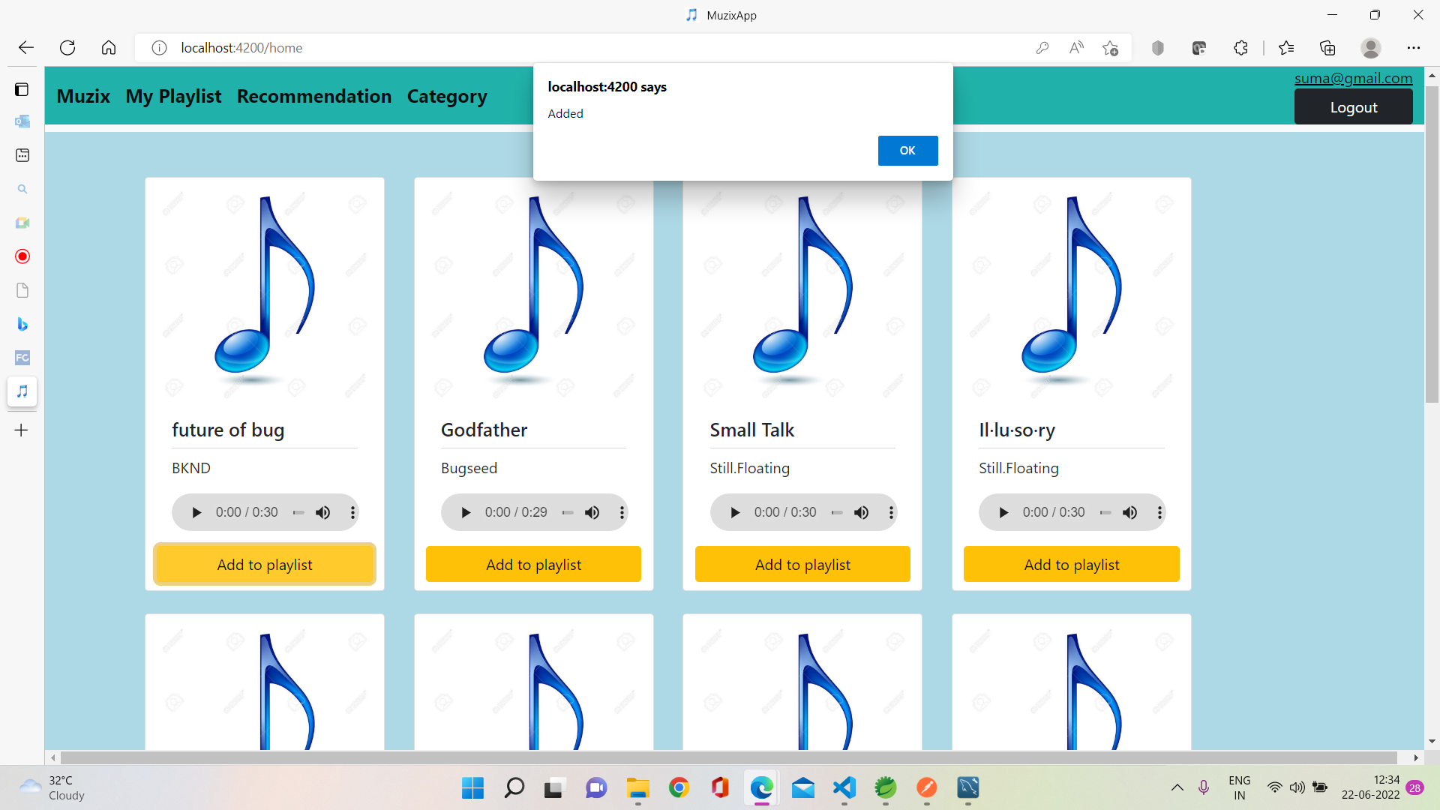
HOME PAGE

Slide 16
FAVOURITE PAGE
This page will display all the songs added as favorite by user
In this page two buttons will be there with each song
Delete button, which will remove particular song from favourite list
Recommended button, on clicking on recommended button song will go to recommended page

Slide 17
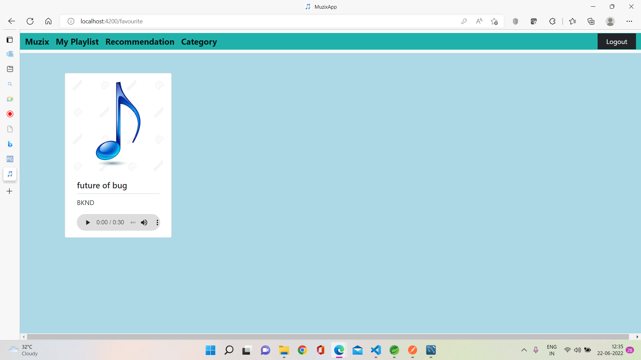
FAVOURITE PAGE

Slide 18
RECOMMEND PAGE
This page will show all the songs which selected by user as recommended
With song name
If we delete the song from favourite it will automatically delete from recommend page

Slide 19

RECOMMEND PAGE

Slide 20
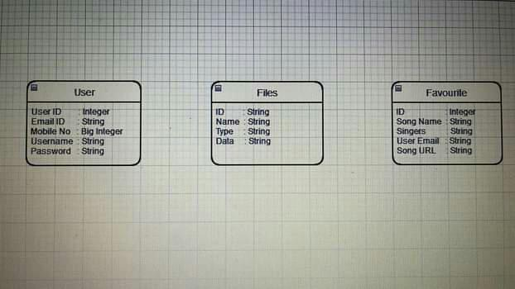
CLASS DIAGRAM

Slide 21
TECHNOLOGIES
Angular
Typescript
Spring Boot Data JPA(microservices)
MySQL
Postman(For Testing the web services)

Slide 22
CONCLUSION
We have created and developed a web application called Muzix App.
It is helpful for many people who can listen to any specific song .
Add them into favorites list and view recommended playlist.
We have developed this using Angular, Spring tool suite and MySQL.

Slide 23
THANK YOU

